Slide 1
Store’s Sales Forecasting
Students
MHD alhussein - MHD kenan alakkad - MHD fakher aqeel

Slide 2
Introduction & Project aim
Introduction: Sales forecasting is a critical process in the world of business. It involves predicting future sales based on historical data, market trends, and other relevant factors.
Project Aim: to use a forecasting model which has:
Based on the reference study we did before in this domain highlights the effectiveness of various statistical methods in sales forecasting:
The Ability To Predict Sales Based On Available Datasets. | Provide Visuals That Can Be Easily Understood.
The Vision Of This Project Is To Take The Process Of Sales Forecasting To The Next Level Which Will Benefit All Sides Of Businesses.
Linear Regression | ARIMA (Autoregressive Integrated Moving Average) | the Holt-Winters Triple Exponential Smoothing
Offers a straightforward approach by identifying relationships between sales and other variables. | Excels in handling data with trends and seasonal patterns. Offers a straightforward approach by identifying relationships between sales and other variables. | Further refines predictions by considering level, trend, and seasonal components of sales data Results: making it a robust tool for accurate and dynamic sales forecasting.

Slide 3
Working steps
First Step: Data Preparation For The Project:
Second step: key steps taken in the project, Data Cleaning and Preprocessing, EDA, Feature Extraction, and Feature Selection:
Data Transformation | Dividing The Dataset Into Multiple Files | Ensure The Effectiveness Of Our Forecasting Models
To tailor the data to our specific analysis needs. | To representing each different item. Created a comprehensive file encompassing all items. Results: perform detailed forecasts for individual items & a holistic forecast for the entire inventory. | Representing the data in a comprehensible and actionable format for the models. For Example: standardizing data formats, normalizing values, & encoding categorical data. Results: laying a solid foundation for accurate and insightful forecasting.
Data Cleaning and Preprocessing | During the Exploratory Data Analysis (EDA) | Feature Extraction | Feature Selection
refined our sales data. addressing issues like missing values and inconsistencies. standardized for analysis. | visualized trends and patterns. For Example: detective piecing together clues. | derived new insights from our data. For Example: we calculated rolling means and maximums to capture short-term trends. | For Example: lagged sales & rolling statistics. ensuring the models are focused on the most relevant predictors for accurate sales forecasting.

Slide 4
Working steps
Third step: key steps shared among the different forecasting models:
Forecasting in action:
Data Preprocessing | Feature Engineering | Data Splitting | Model Fitting | Forecasting
Load data. filter for specific conditions format dates. | Create date-related features. For some models add additional lag and rolling window features. | Divide the dataset into training and testing sets based on a specific date. | Apply different forecasting models (ARIMA/SARIMAX, Linear Regression, Holt-Winters) to the training data. | Use models to predict future sales on the test dataset.
Error Analysis
Calculate MAE, RMSE, and MAPE to evaluate forecast accuracy.
Visualization
Plot actual vs. predicted sales and forecast errors for model performance analysis.
Data visualization | First model: Linear regression | Second model: ARIMA
Plots which shows some good over all insight on the dataset | Plots shows the sales forecasting and errors done on the dataset | Plots shows the sales forecasting and errors done on the dataset

Slide 5
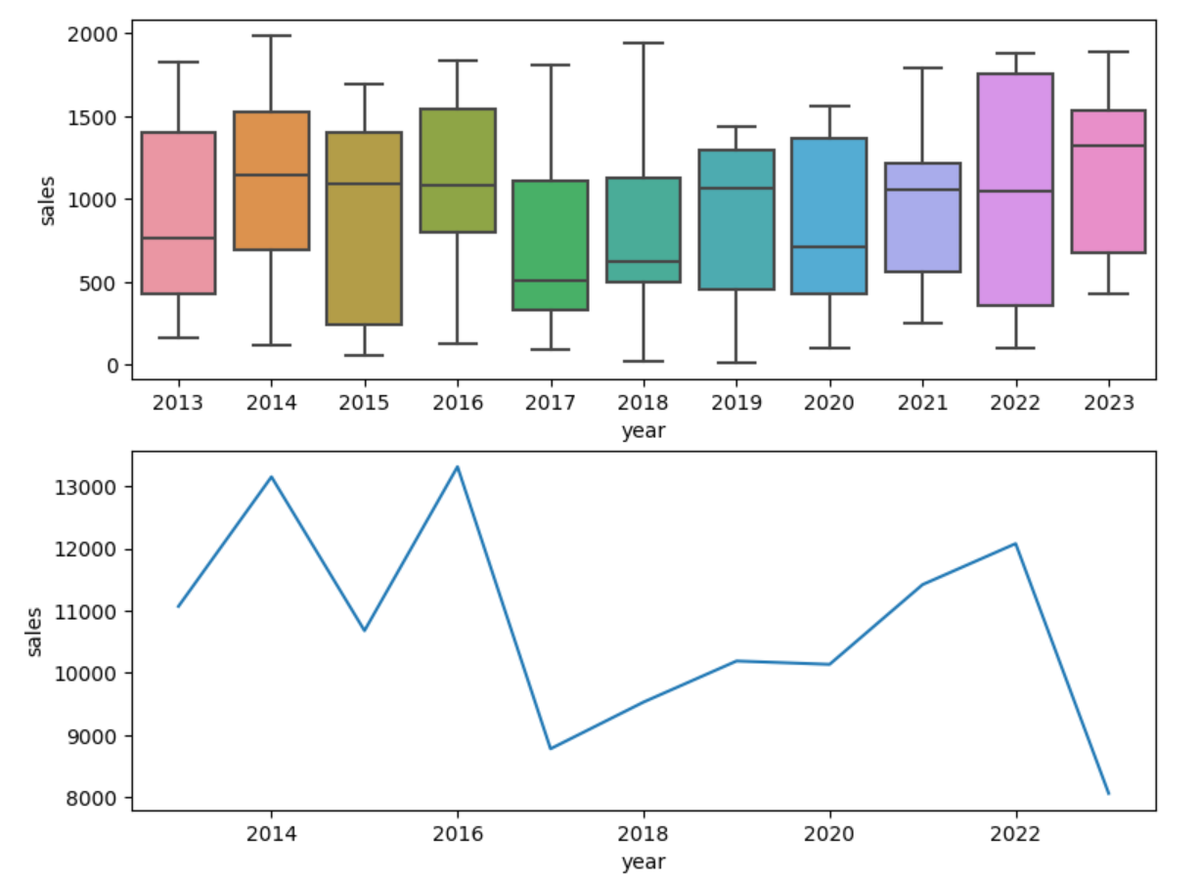
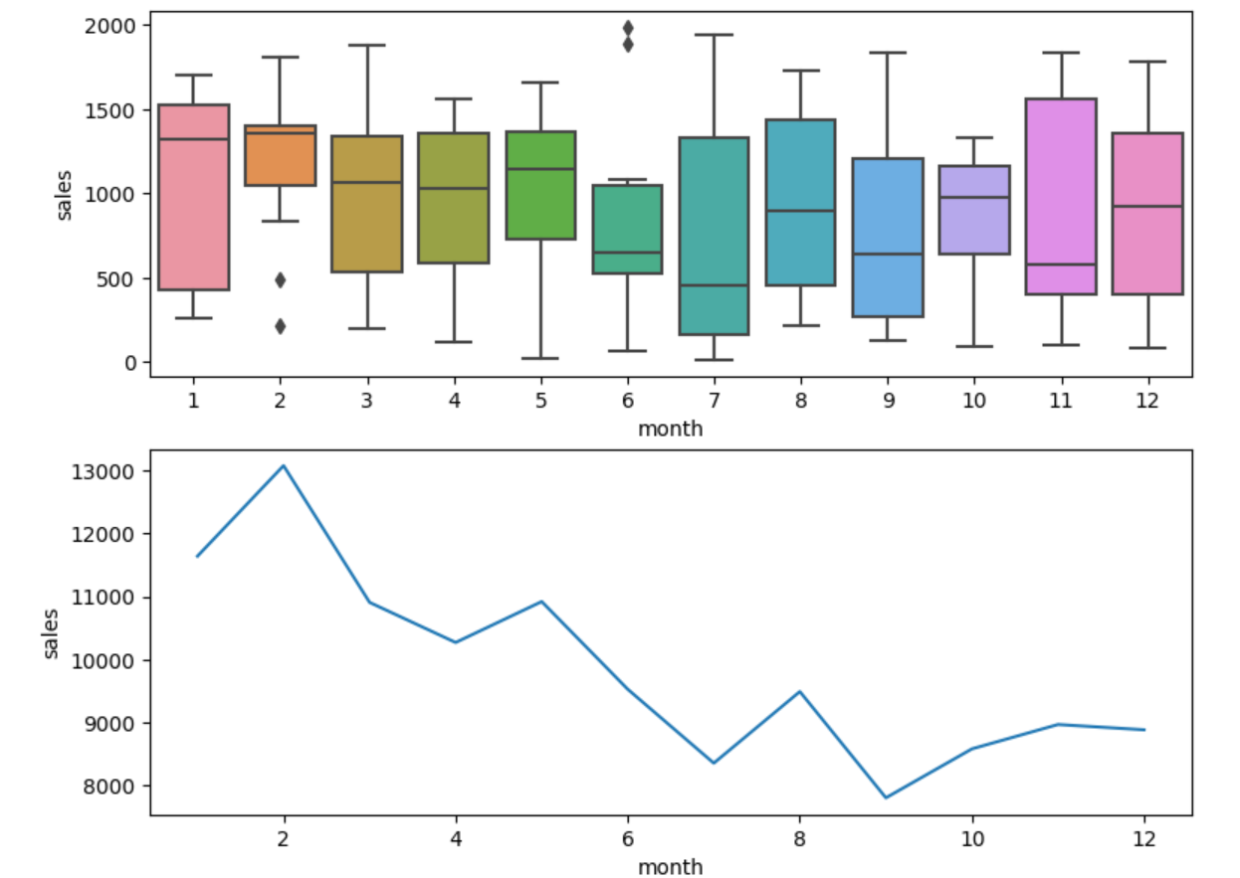
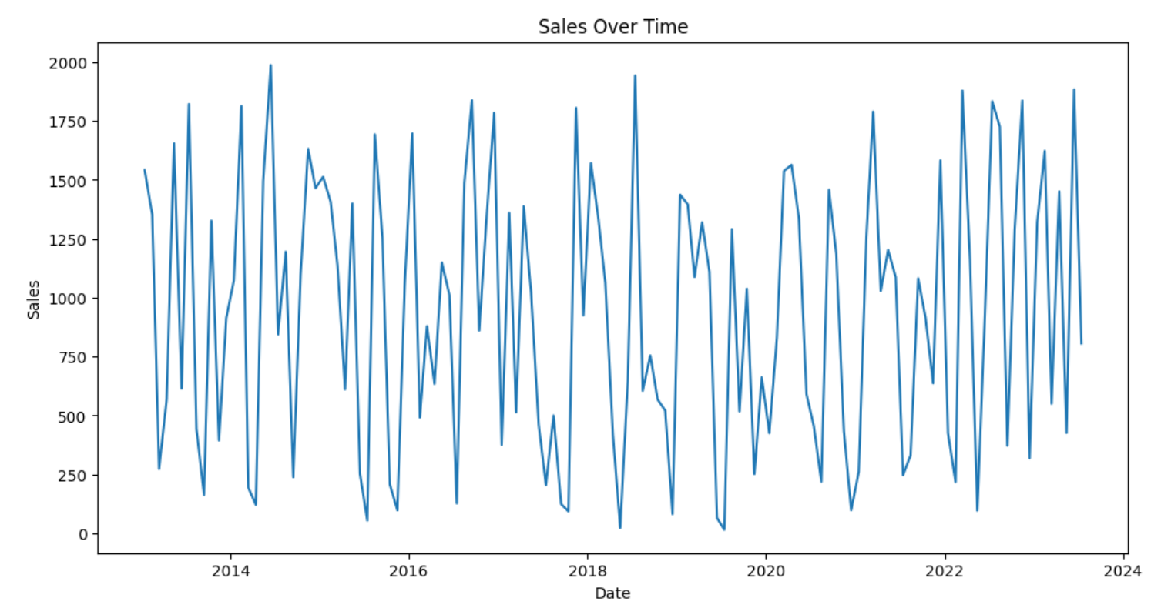
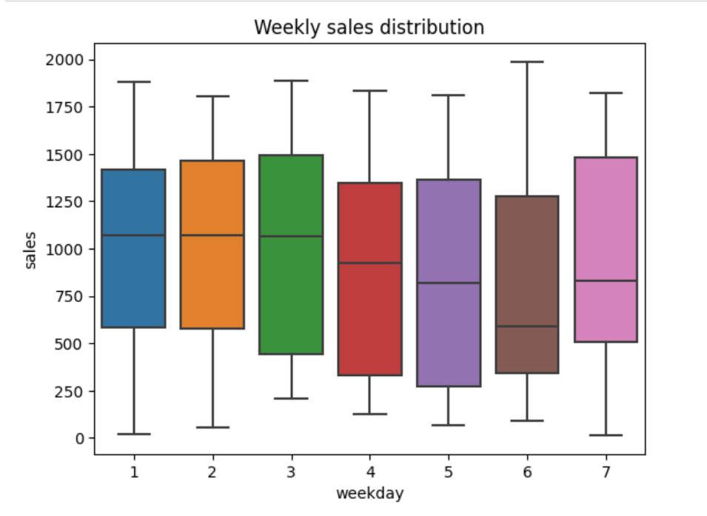
Forecasting In Action
Forecasting in action: Data visualization:

Slide 6
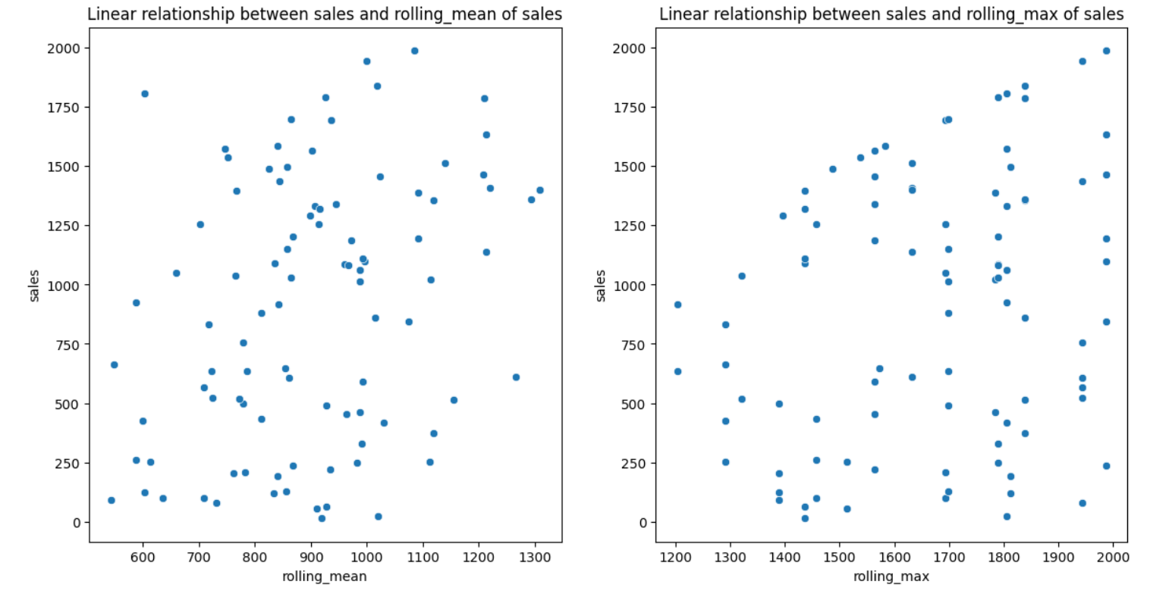
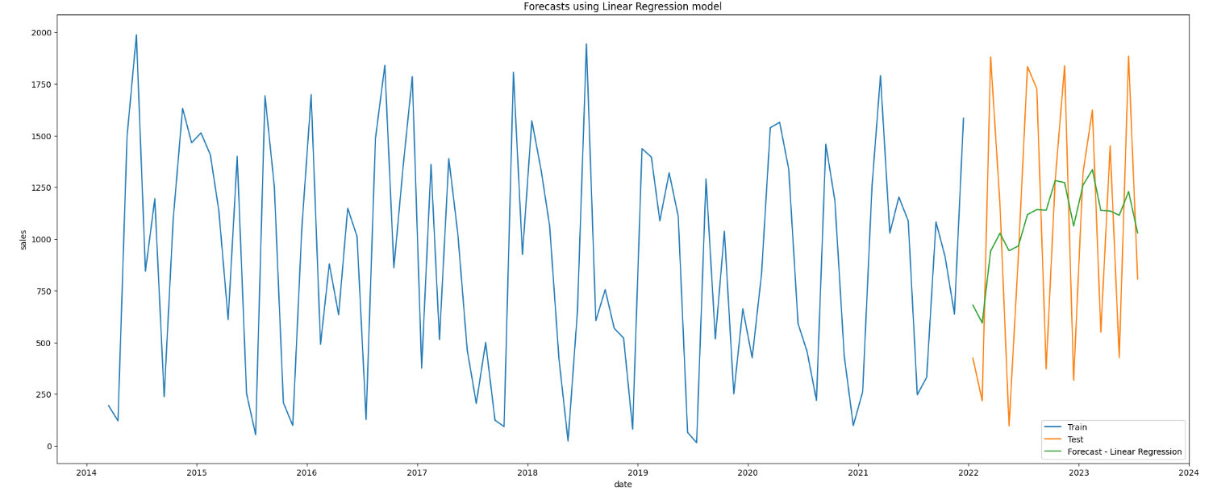
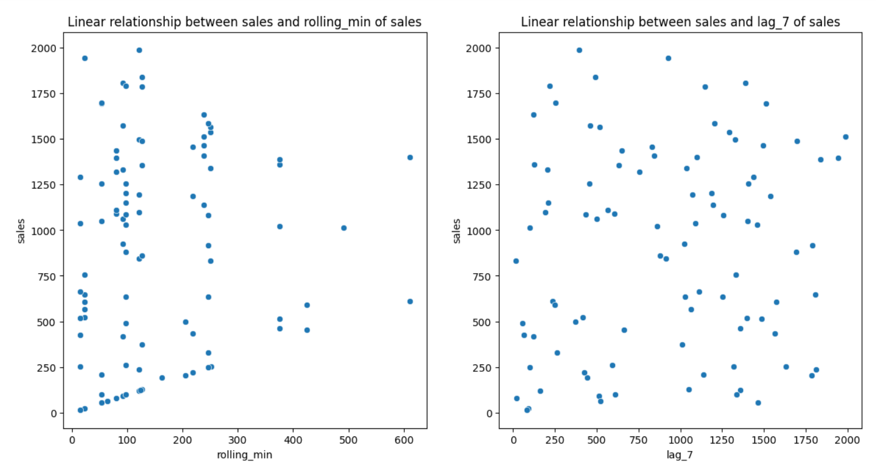
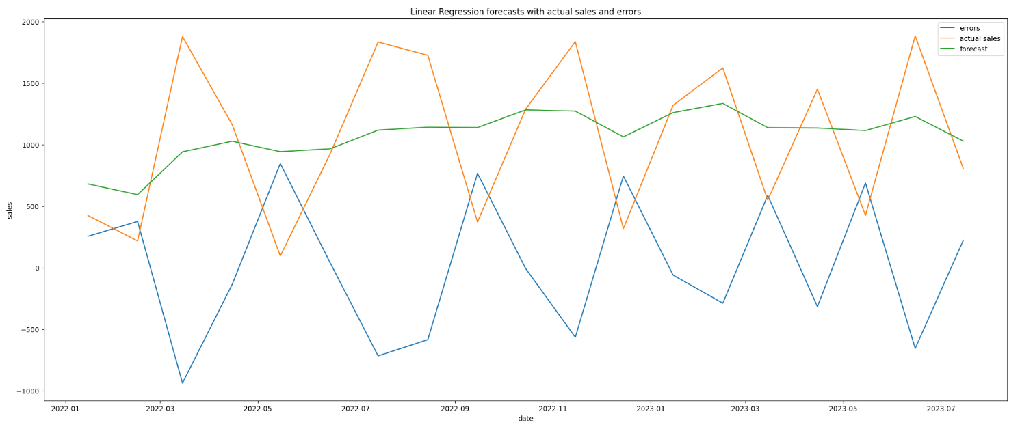
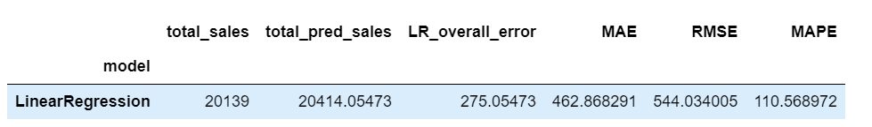
Forecasting In Action
Forecasting in action: Linear regression:

Slide 7
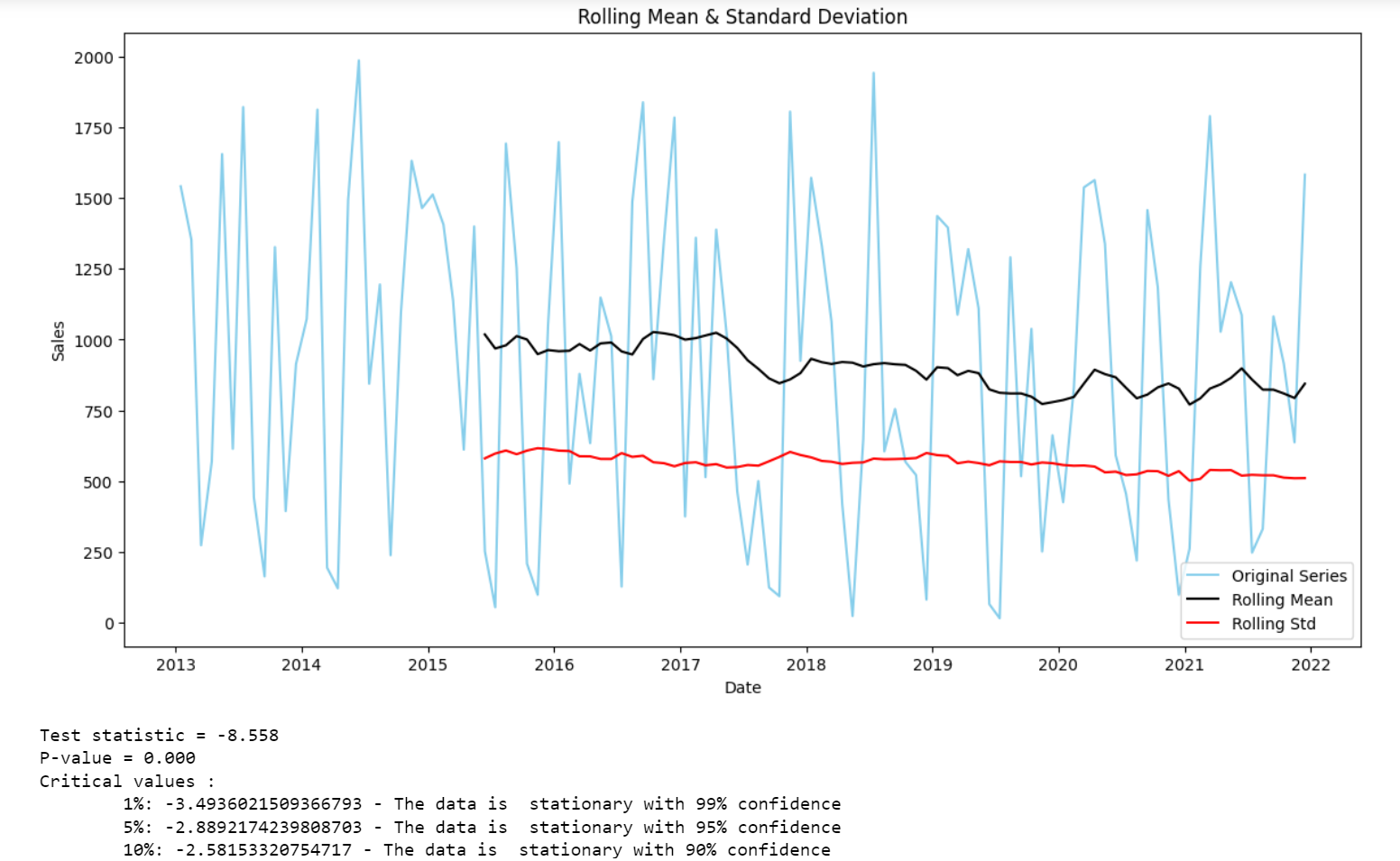
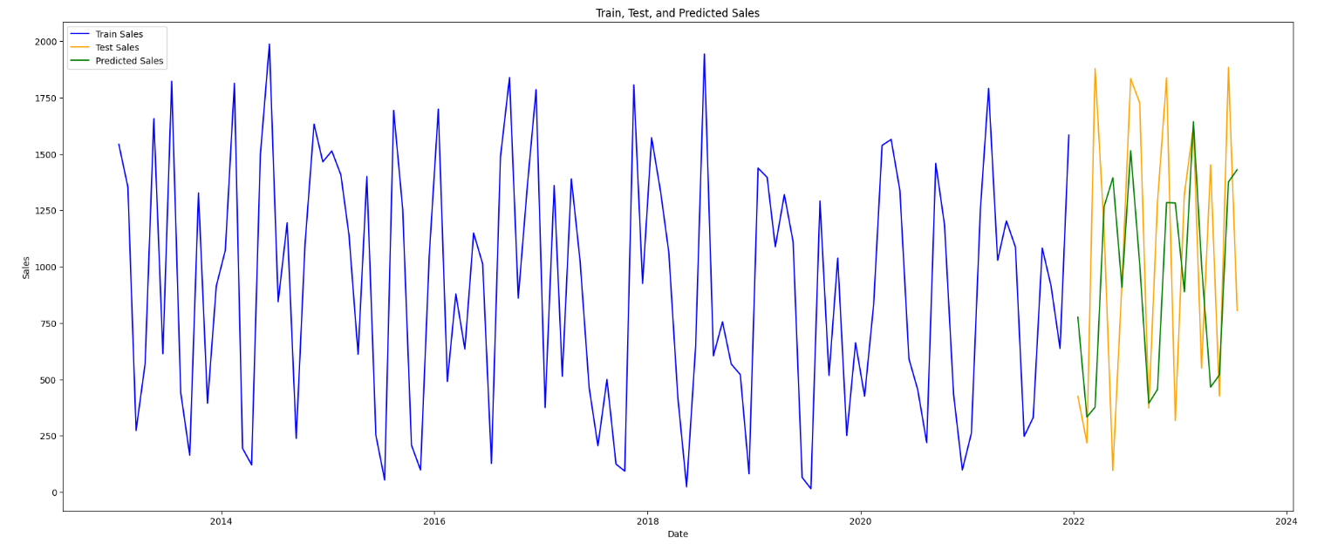
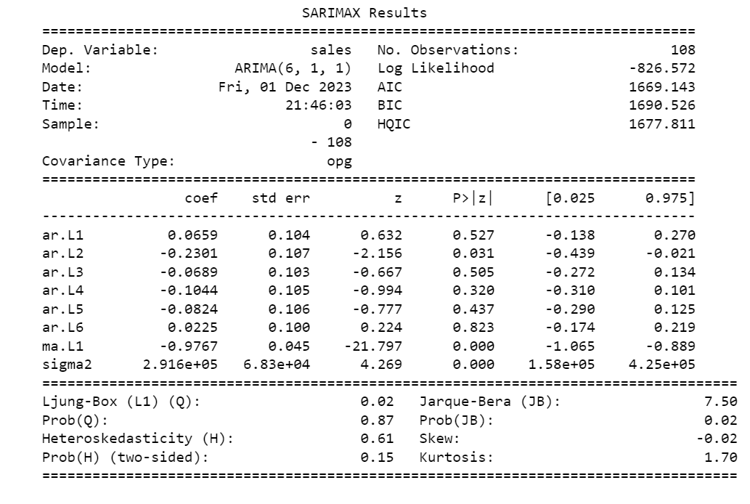
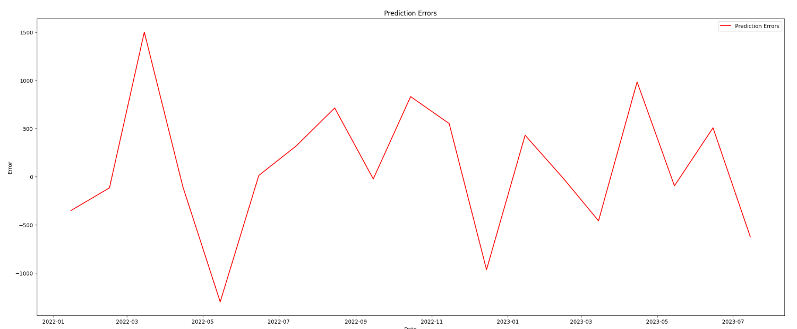

Forecasting In Action
Forecasting in action: ARIMA:

Slide 8
Forecasting In Action
Forecasting in action: now we have reviewed the two models & and the results of each model and how accurate was that model, in the upcoming days we will work on another model (Holt-Winters and Triple Exponential Smoothing), this model has another great feature which we are exploring at the moment while trying to build the model.
This model will help us compare not one or two but three models so that we can forecast sales in the best way possible.
In addition currently we are working on the table of comparisons and we will delve deep into each model so we can get the most out of each one.
Example of considerations which we will take such as MAE, RMSE, MAPE, and other metrics.

Slide 9
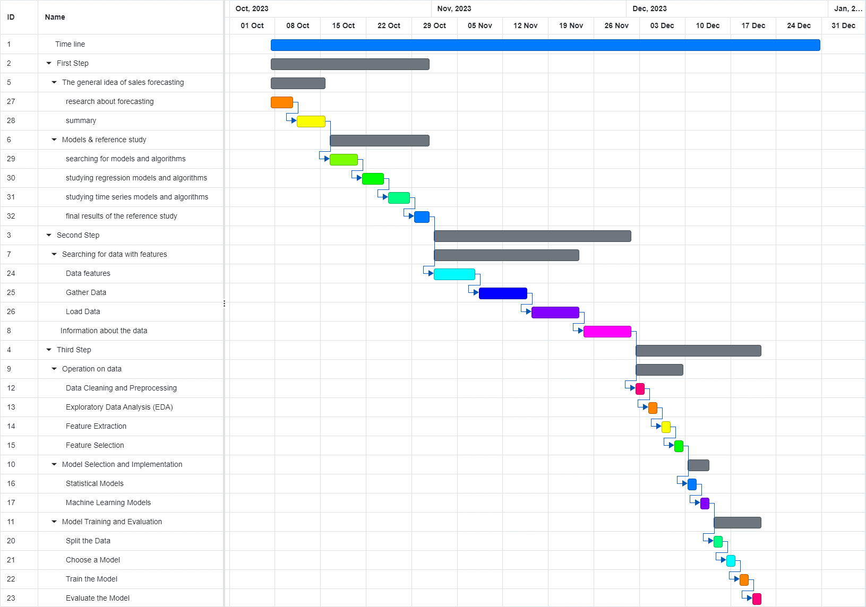
Gantt Chart
Working steps according to our Gannt chart:
Thank You!

